Slide 1
BASIS PATH TESTING DERIVING TEST CASES

Slide 2
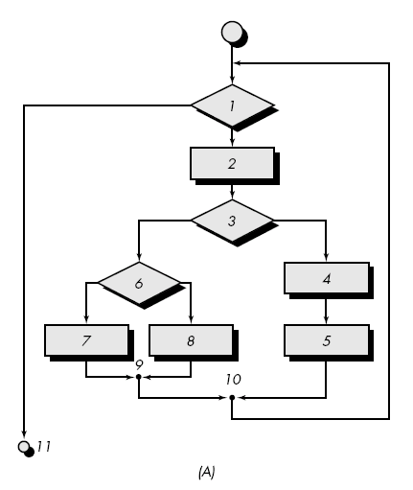
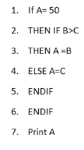
FlowGraph

Slide 3
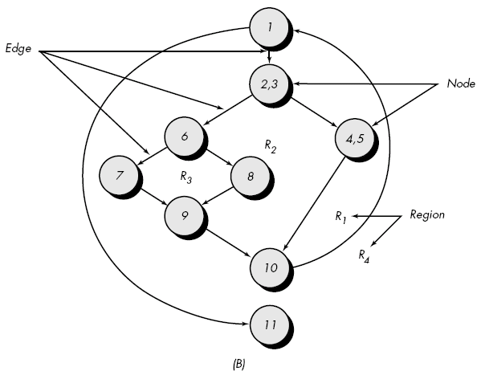
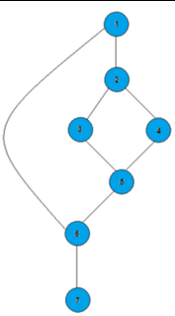
Solution

Slide 4
Independent program paths
Path 1: 1-11
Path 2: 1-2-3-4-5-10-1-11
Path 3: 1-2-3-6-8-9-10-1-11
Path 4: 1-2-3-6-7-9-10-1-11
Path 5: 1-2-3-4-5-10-1-2-3-6-8-9-10-1-11
Path 1: 1,2,3,5,6, 7
Path 2: 1,2,4,5,6, 7
Path 3: 1, 6, 7

Slide 5
Cyclomatic complexity
It is a quantitative measure of independent paths in the source code of a software program.
Cyclomatic complexity can be calculated by using control flow graphs or concerning functions, modules, methods or classes within a software program.
An Independent path is defined as a path that has at least one edge that has not been traversed before in any other path.
1. The no. of regions corresponds to the cyclomatic complexity.
2. Cyclomatic complexity, V(G), for a flow graph, G, is defined as
V(G) = E - N + 2
where E is the number of flow graph edges, N is the number of flow graph nodes.
3. Cyclomatic complexity, V(G), for a flow graph, G, is also defined as
V(G) = P + 1
where P is the number of predicate nodes edges.

Slide 6
Regions:
V(G) = 4 regions
Edge and Node:
V(G) = Edge – Node +2
V(G) = 11 – 9 + 2
V(G) = 4
Predicate Nodes:
V(G) = Predicate Nodes + 1
V(G) = 3 + 1
V(G) = 4

Slide 7
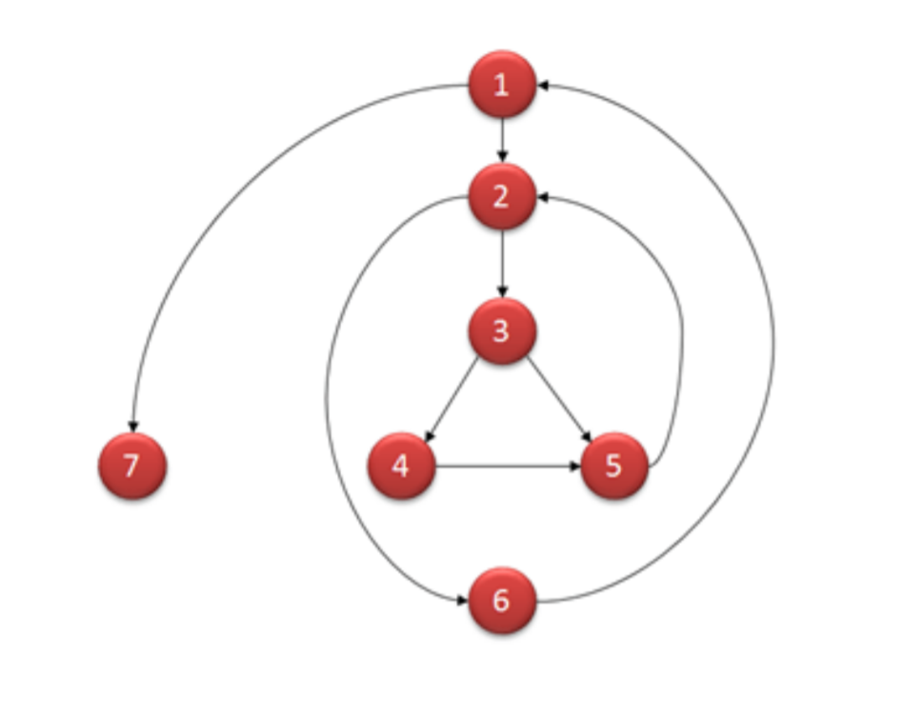
Determine Cyclomatic complexity in all the ways

Slide 8
EXAMPLE

Slide 9
PROCEDURE
This procedure computes the average of 100 or fewer numbers that lie between bounding values
It also computes the sum and the total number valid.

Slide 10
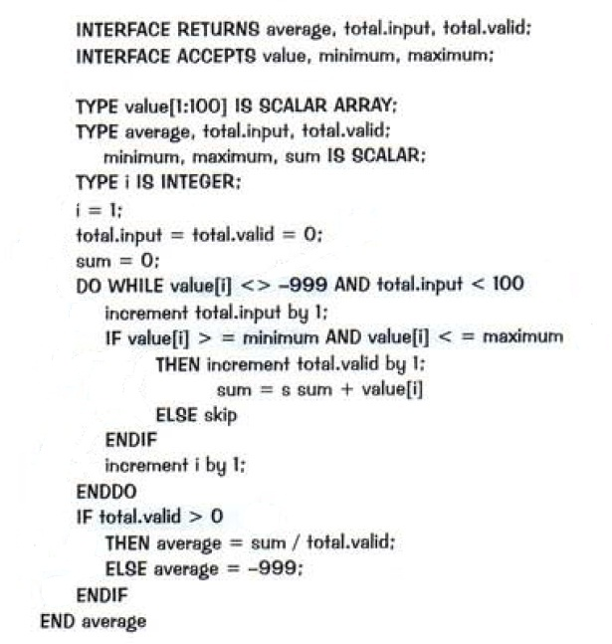

Slide 11
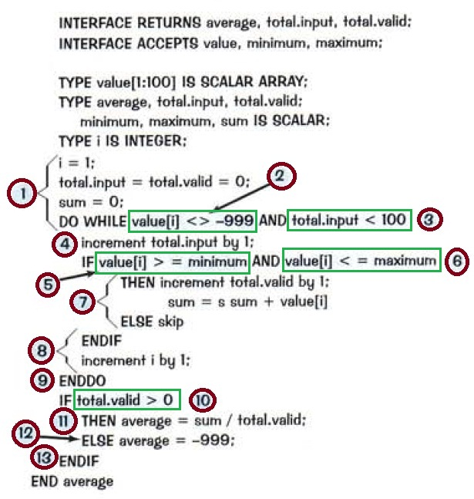

Slide 12
STEP - 1
Using the design or code as a foundation, Draw a corresponding flow graph

Slide 13
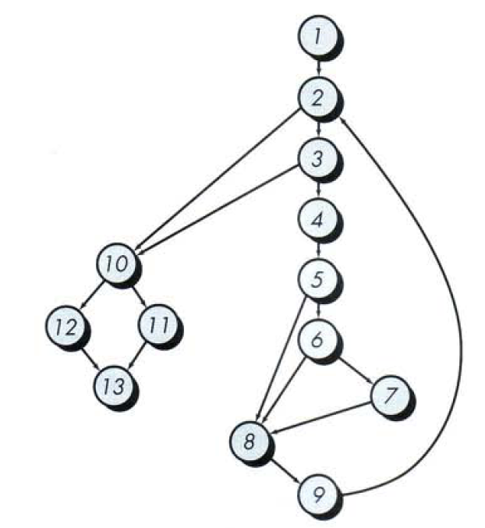

Slide 14
STEP - 2
Determine the cyclomatic complexity of the resultant flow graph

Slide 15
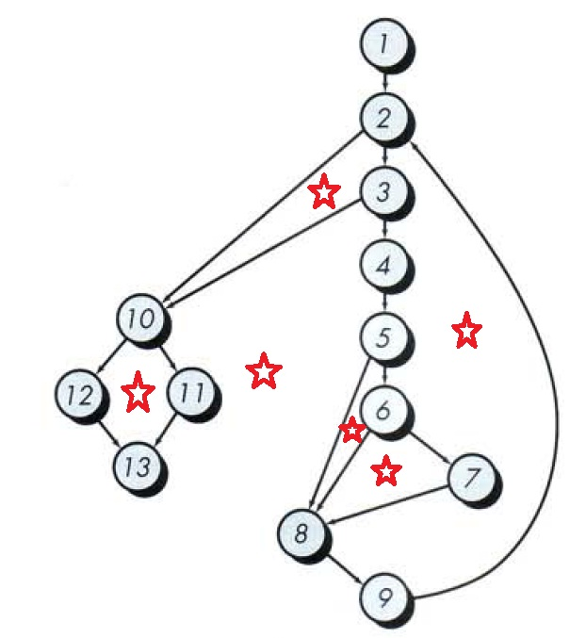
REGIONS

Slide 16
Regions:
V(G) = 6 regions
Edge and Node:
V(G) = Edge – Node +2
V(G) = 17 – 13 + 2
V(G) = 6
Predicate Nodes:
V(G) = Predicate Nodes + 1
V(G) = 5 + 1
V(G) = 6

Slide 17
STEP - 3
Determine the basis set of linearly independent paths.

Slide 18
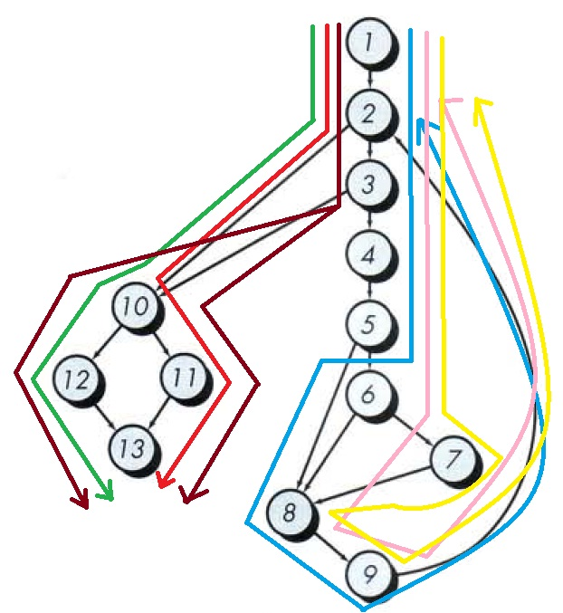

Slide 19
PATH – 1 :
1-2-10-11-13
PATH – 2 :
1-2-10-12-13
PATH – 3 :
1-2-3-10-11-13
PATH – 4 :
1-2-3-4-5-8-9-2-….
PATH – 5 :
1-2-3-4-5-6-8-9-2-….
PATH – 6 :
1-2-3-4-5-6-7-8-9-2-….

Slide 20
STEP - 4
Prepare a test cases that will force execution of each path in the basis

Slide 21
PATH – 1 :
1-2-10-11-13
PATH – 2 :
1-2-10-12-13
PATH – 3 :
1-2-3-10-11-13
PATH – 4 :
1-2-3-4-5-8-9-2-….
PATH – 5 :
1-2-3-4-5-6-8-9-2-….
PATH – 6 :
1-2-3-4-5-6-7-8-9-2-….

Slide 23
INPUT | EXPECTED OUTPUT | PASS / FAIL
Test Case – 1 Path – 1
Sum = 45 , Total valid = 10 Value [1] = - 999 | Average = 4.5 | Pass
Test Case – 2 Path – 2
Sum = 100 , Total valid = 0 Value [1] = - 999 | Average = - 999 | Pass
Test Case – 3 Path – 3
Min = 1, Max = 11, Total.input = 101 Value[1, 2, 3, …., 101] Sum = 100 | Average = 0.9 | Pass

Slide 24
INPUT | EXPECTED OUTPUT | PASS / FAIL
Test Case – 4 Path – 4
Min = 1, Max = 10, Value[0, 2, 3, …., 10] Min = 1, Max = 10, Value[1, 2, 3, …., 10,0] | Average = - 999 Average = 4.5 | Pass Pass
Test Case – 5 Path – 5
Min = 1, Max = 11, Value[1, 2, 3, …., 11] Min = 1, Max = 11, Value[11, 2, 3, …., 10] | Average = 4.5 Average = - 999 | Pass Pass

Slide 25
INPUT | EXPECTED OUTPUT | PASS / FAIL
Test Case – 6 Path – 6
Min = 1, Max = 11, Value[1, 2, 3, …., 10] | Average = 4.5 | Pass

Slide 26
Function to delete element
Function fn_delete_element (int value, int array_size, int array[])
{
int i;
location = array_size + 1;
for i = 1 to array_size
if ( array[i] == value )
location = i;
end if;
end for;
for i = location to array_size
array[i] = array[i+1];
end for;
array_size --;
}

Slide 27
Function fn_delete_element (int value, int array_size, int array[])
{
1 int i;
location = array_size + 1;
2 for i = 1 to array_size
3 if ( array[i] == value )
4 location = i;
end if;
end for;
5 for i = location to array_size
6 array[i] = array[i+1];
end for;
7 array_size --;
}

Slide 28
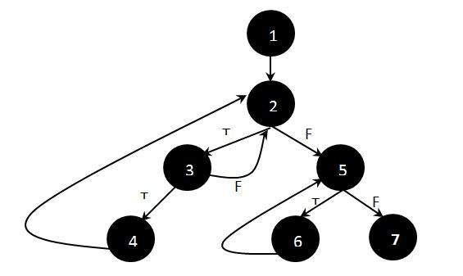
Flow graph

Slide 29
Independent Paths
Path 1: 1 - 2 - 5 - 7
Path 2: 1 - 2 - 5 - 6 - 7
Path 3: 1 - 2 - 3 - 2 - 5 - 6 - 7
Path 4: 1 - 2 - 3 - 4 - 2 - 5 - 6 - 7

Slide 30
Advantages of Basic Path Testing
It helps to reduce the redundant tests
It focuses attention on program logic
It helps facilitates analytical versus arbitrary case design
Test cases which exercise basis set will execute every statement in a program at least once

